Slide 1
Designing the Data Warehouse
Dimensional Modeling:
To create a data warehouse system we must determine how we are going to extract meaningful data and logically group the data.
Multidimensional modeling is a technique for structuring data around the business concepts.

Slide 2
Data is modeled and viewed in multiple dimensions.
These dimensions are the perspectives or entities with respect to which an organization wants to keep records.
AllElectronics may create a sales data warehouse in order to keep records of the store’s sales with respect to the dimensions time , product , customer and store.

Slide 3
Information Package Diagram
First step is to prepare an information package, that allows the data warehouse’s designers to layout the requirements for the dimension tables, their hierarchies, and the facts to be modeled.

Slide 4
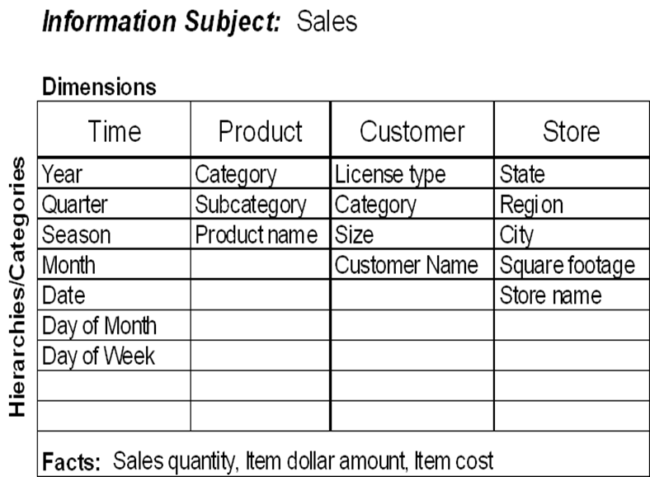

Slide 5
Dimension Tables:
The information package is then used to create the dimension tables.

Slide 6
The Fact Table
The fact table used for this project was based on sales information.
Sales fact table
ProductID | Fact table keys (PK)
StoreID
CustomerID
TimeID
Sales quantity | Measures
Item dollor amount
Item cost

Slide 7
Dimensional Modeling
All products are grouped into categories and each category if further divided into several subcategories
This allows related items to be grouped and summarized for high level analysis while retaining the ability to drill down to more specific product detail

Slide 8
Dimensional Modeling
Store Dimension
Product Dimension
Total
Total
Region
Manufacturer
District
Brand
Stores
Products
Notes:
1
The simple model we will use to demonstrate the various design alternatives is composed of three dimensions. Only two are shown, Store and Product. The third, Time, is composed of the following attribute hierarchy: date -> month -> quarter -> year.
The Store dimension has an attribute hierarchy of store -> district -> region. Products is composed of products -> brand -> manufacturer.
Based on this simple model, we can see that the granularity of data is products sold in stores by day.

Slide 9
Dimensional Modeling
Customers are organized into three hierarchies: size, license type and category; and each has further hierarchies
The A/C sales are high during the summer, but heating sales are high in winter, thus Time dimension is categorized in two categories
Customer |  |  | Time
Size | License Type | Category | Calendar | Seasonal
Small (2-3 techs) Medium (4-10 techs) Large (11-20 techs) Corporate (21+ techs) | “A” license (HVAC and refrigeration) “B” license (HVAC only) | HVAC Builder Government Refrigeration Maintenance | Year Quarter Month Day | Year Season Month Day of the week

Slide 10
E-R modeling for OLTP systems
OLTP systems capture details of events or transactions
OLTP systems focus on individual events
An OLTP system is a window into micro-level transactions
Picture at detail level necessary to run the business
Suitable only for questions at transaction level
Data consistency, non-redundancy, and efficient data storage critical

Slide 11
E-R modeling for OLTP systems.
Entity-Relationship Modeling
Removes data redundancy
Ensures data consistency
Expresses microscopic relationships

Slide 12
Dimensional modeling for the data warehouse.
DW meant to answer questions on overall process
DW focus is on how managers view the business
DW reveals business trends
Information is centered around a business process
Answers show how the business measures the process
The measures to be studied in many ways along several business dimensions.

Slide 13
Dimensional modeling for the data warehouse.
Dimensional Modeling
Captures critical measures
Views along dimensions
Intuitive to business users

Slide 14
Data Warehouse Schema
Modeling data warehouses: dimensions & measures
Star schema: A fact table in the middle connected to a set of dimension tables
Snowflake schema: A refinement of star schema where some dimensional hierarchy is normalized into a set of smaller dimension tables, forming a shape similar to snowflake
Fact constellations: Multiple fact tables share dimension tables, viewed as a collection of stars, therefore called galaxy schema or fact constellation
The major focus will be on the star schema which is commonly used in the design of many data warehouse.

Slide 15
Star Schema
This is the most common modeling paradigm for designing data warehouse.
In this model a data warehouse consists of:
a large central table (fact table) containing the bulk of the data, with no redundancy,
a set of smaller attendant tables (dimension tables), one for each dimension. Dimension tables are not normalized
The diagram below show an example of star schema

Slide 16
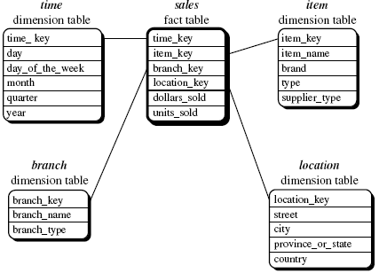
Star Schema
Star schema of a data warehouse for sales.

Slide 17
Example of Star Schema
time
time_key
day
day_of_the_week
month
quarter
year
item
item_key
item_name
brand
type
supplier_type
Sales Fact Table
time_key
item_key
branch_key
branch
location
location_key
branch_key
branch_name
branch_type
location_key
street
City
state
country
units_sold
dollars_sold
Measures

Slide 18
Star Schema
A star schema for AllElectronics sales is shown in Figure in the above slide. Sales are considered along four dimensions namely, time, item, branch, and location.
The schema contains a central fact table for sales that contains keys to each of the four dimensions, along with two measures: dollars sold and units sold.
To minimize the size of the fact table, dimension identifiers (such as time key and item key) are system-generated identifiers.

Slide 19
Star Schema
Notice that in the star schema, each dimension is represented by only one table, and each table contains a set of attributes.
For example, the location dimension table contains the attribute set {location key, street, city, province or state, country}

Slide 20
Example of Snowflake Schema
time
item
time_key
day
day_of_the_week
month
quarter
year
item_key
item_name
brand
type
supplier_key
supplier
Sales Fact Table
supplier_key
supplier_type
time_key
item_key
branch_key
branch
location
location_key
location_key
street
city_key
branch_key
branch_name
branch_type
units_sold
city
dollars_sold
city_key
city
state
country
Measures

Slide 21
Example of Fact Constellation
time
time_key
day
day_of_the_week
month
quarter
year
item
Shipping Fact Table
item_key
item_name
brand
type
supplier_type
Sales Fact Table
time_key
time_key
item_key
shipper_key
item_key
branch_key
from_location
branch
location_key
location
to_location
branch_key
branch_name
branch_type
units_sold
location_key
street
city
state
country
dollars_cost
dollars_sold
units_shipped
shipper
Measures
shipper_key
shipper_name
location_key
shipper_type

Slide 22
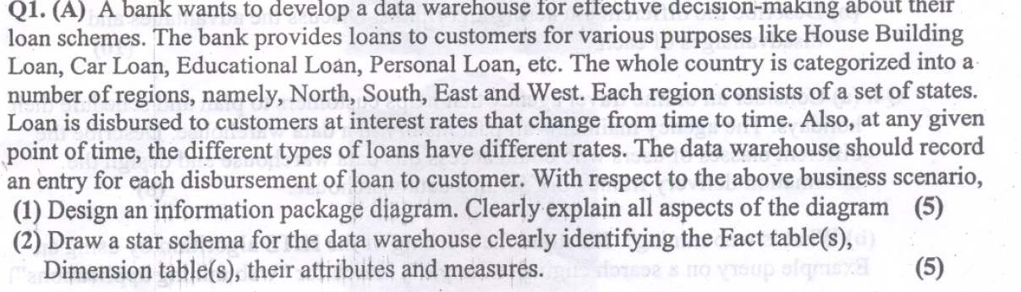
Example

Slide 23
Issues With Data Warehousing
Underestimation of resources for data loading
Hidden problems with source systems
Required data not captured
Increased end-user demands
Data homogenization
High demand for resources
Data ownership
High maintenance
Long duration projects
Complexity of integration

Slide 24
Datalake:
DWH: A data warehouse is a centralized repository of structured and curated data that is extracted, transformed, and loaded (ETL) from various sources.
A data warehouse supports business intelligence (BI) and analytics by providing a consistent and reliable view of the data across different dimensions, such as time, location, product, customer, and so on.
A data warehouse is typically designed with a predefined schema, or a logical structure, that defines the tables, columns, and relationships of the data.
A data lake is a distributed repository of raw and unstructured data that is ingested from various sources in its original format.
A data lake supports data exploration and discovery by allowing users to store and access any type of data, such as text, images, audio, video, and so on.
A data lake is typically designed with a schema-on-read approach, meaning that the structure and meaning of the data are determined at the time of querying, rather than at the time of loading.

Slide 25
Storage:
One of the key differences between data warehouse and data lake architectures is how they store data.
A data warehouse stores data in a structured and normalized way, using relational databases or columnar formats. This reduces data redundancy and improves data quality, but also requires more processing and storage resources.
A data lake stores data in a flat and flexible way, using object storage or file systems. This enables data scalability and diversity, but also increases data complexity and governance challenges.
Processing:
Another key difference between data warehouse and data lake architectures is how they process data.
A data warehouse processes data before loading it into the repository, using ETL tools and pipelines. This ensures that the data is clean, consistent, and ready for analysis, but also limits the scope and speed of data ingestion.
A data lake processes data after loading it into the repository, using various tools and frameworks, such as Hadoop, Spark, or SQL. This enables faster and more diverse data ingestion, but also requires more skills and resources to analyze the data.

Slide 26
use cases
A third key difference between data warehouse and data lake architectures is how they support different use cases. A data warehouse is best suited for use cases that require structured and standardized data for reporting and analysis, such as dashboards, KPIs, or OLAP cubes.
A data warehouse can answer predefined and repeatable questions, such as "What is the monthly revenue by region?" or "How many customers bought product X in the last quarter?".
A data lake is best suited for use cases that require raw and unstructured data for exploration and discovery, such as machine learning, natural language processing, or sentiment analysis.
A data lake can answer ad-hoc and complex questions, such as "What are the main topics of customer reviews?" or "How can we predict customer churn based on behavior patterns?".

Slide 27
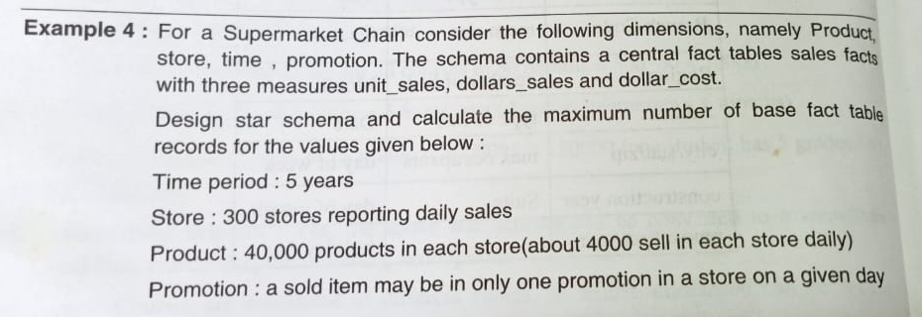

Slide 28
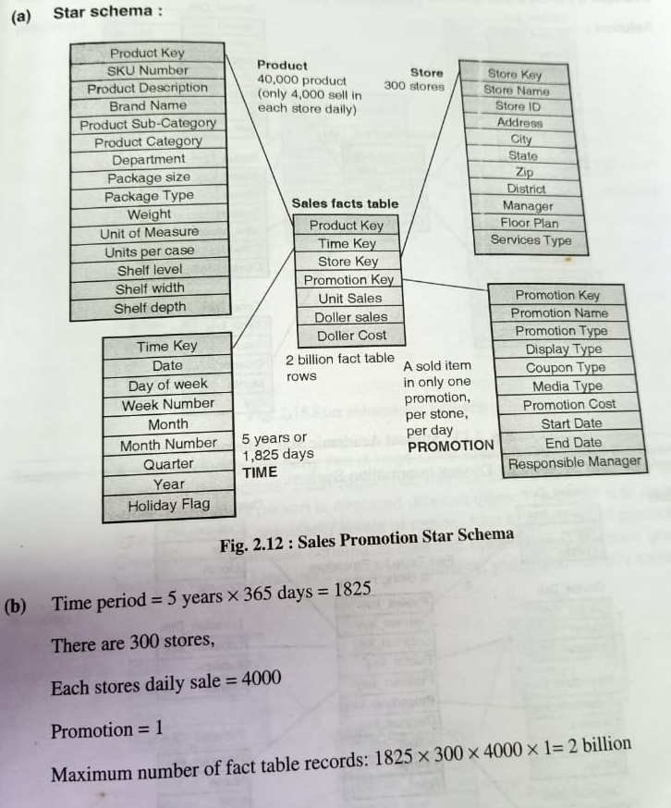

Slide 29
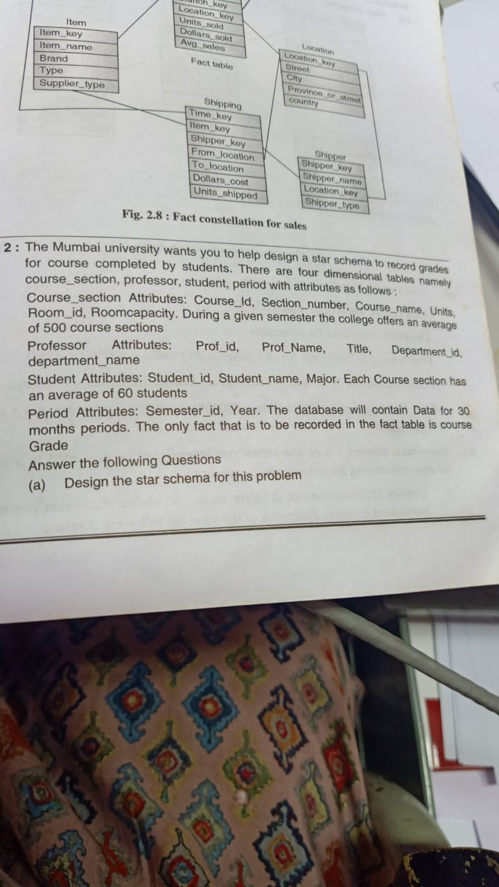
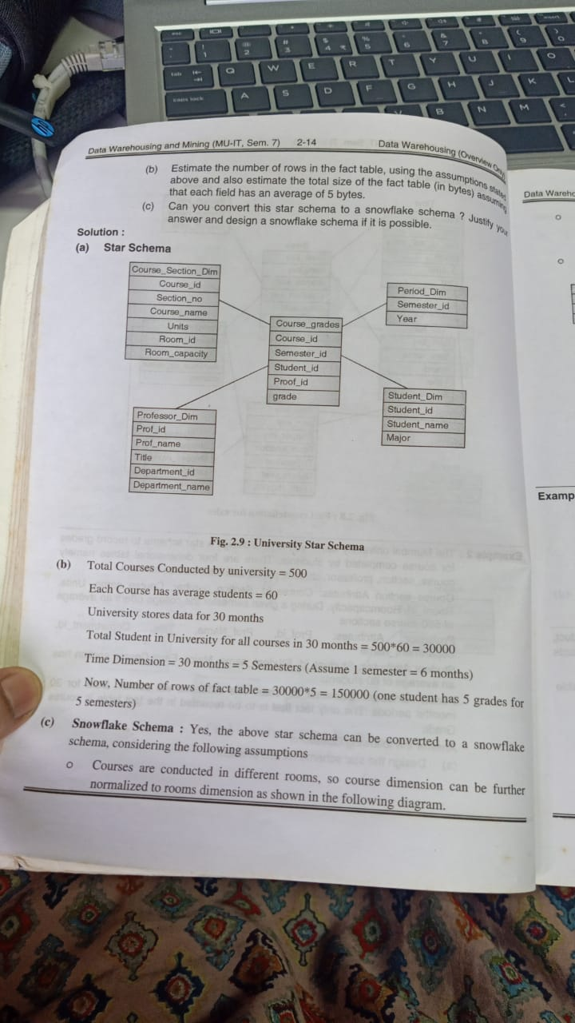

Slide 31
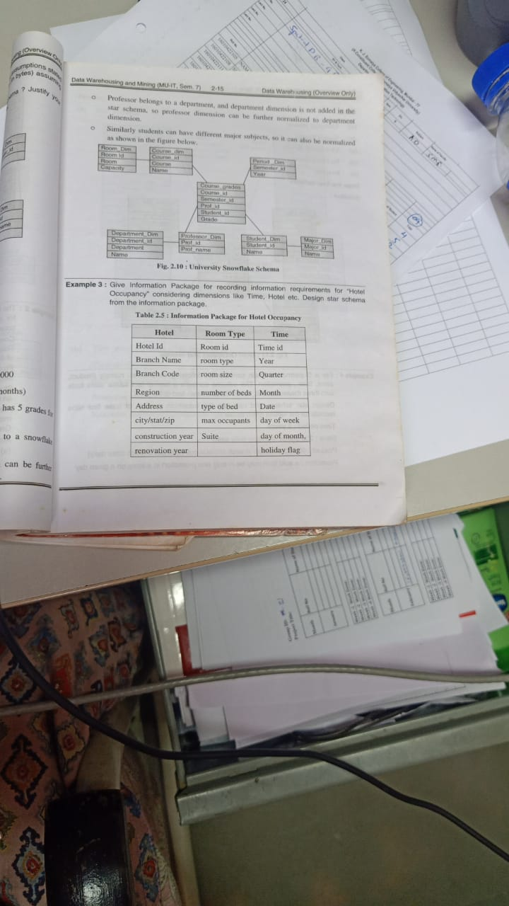

Slide 33
